Slide 1
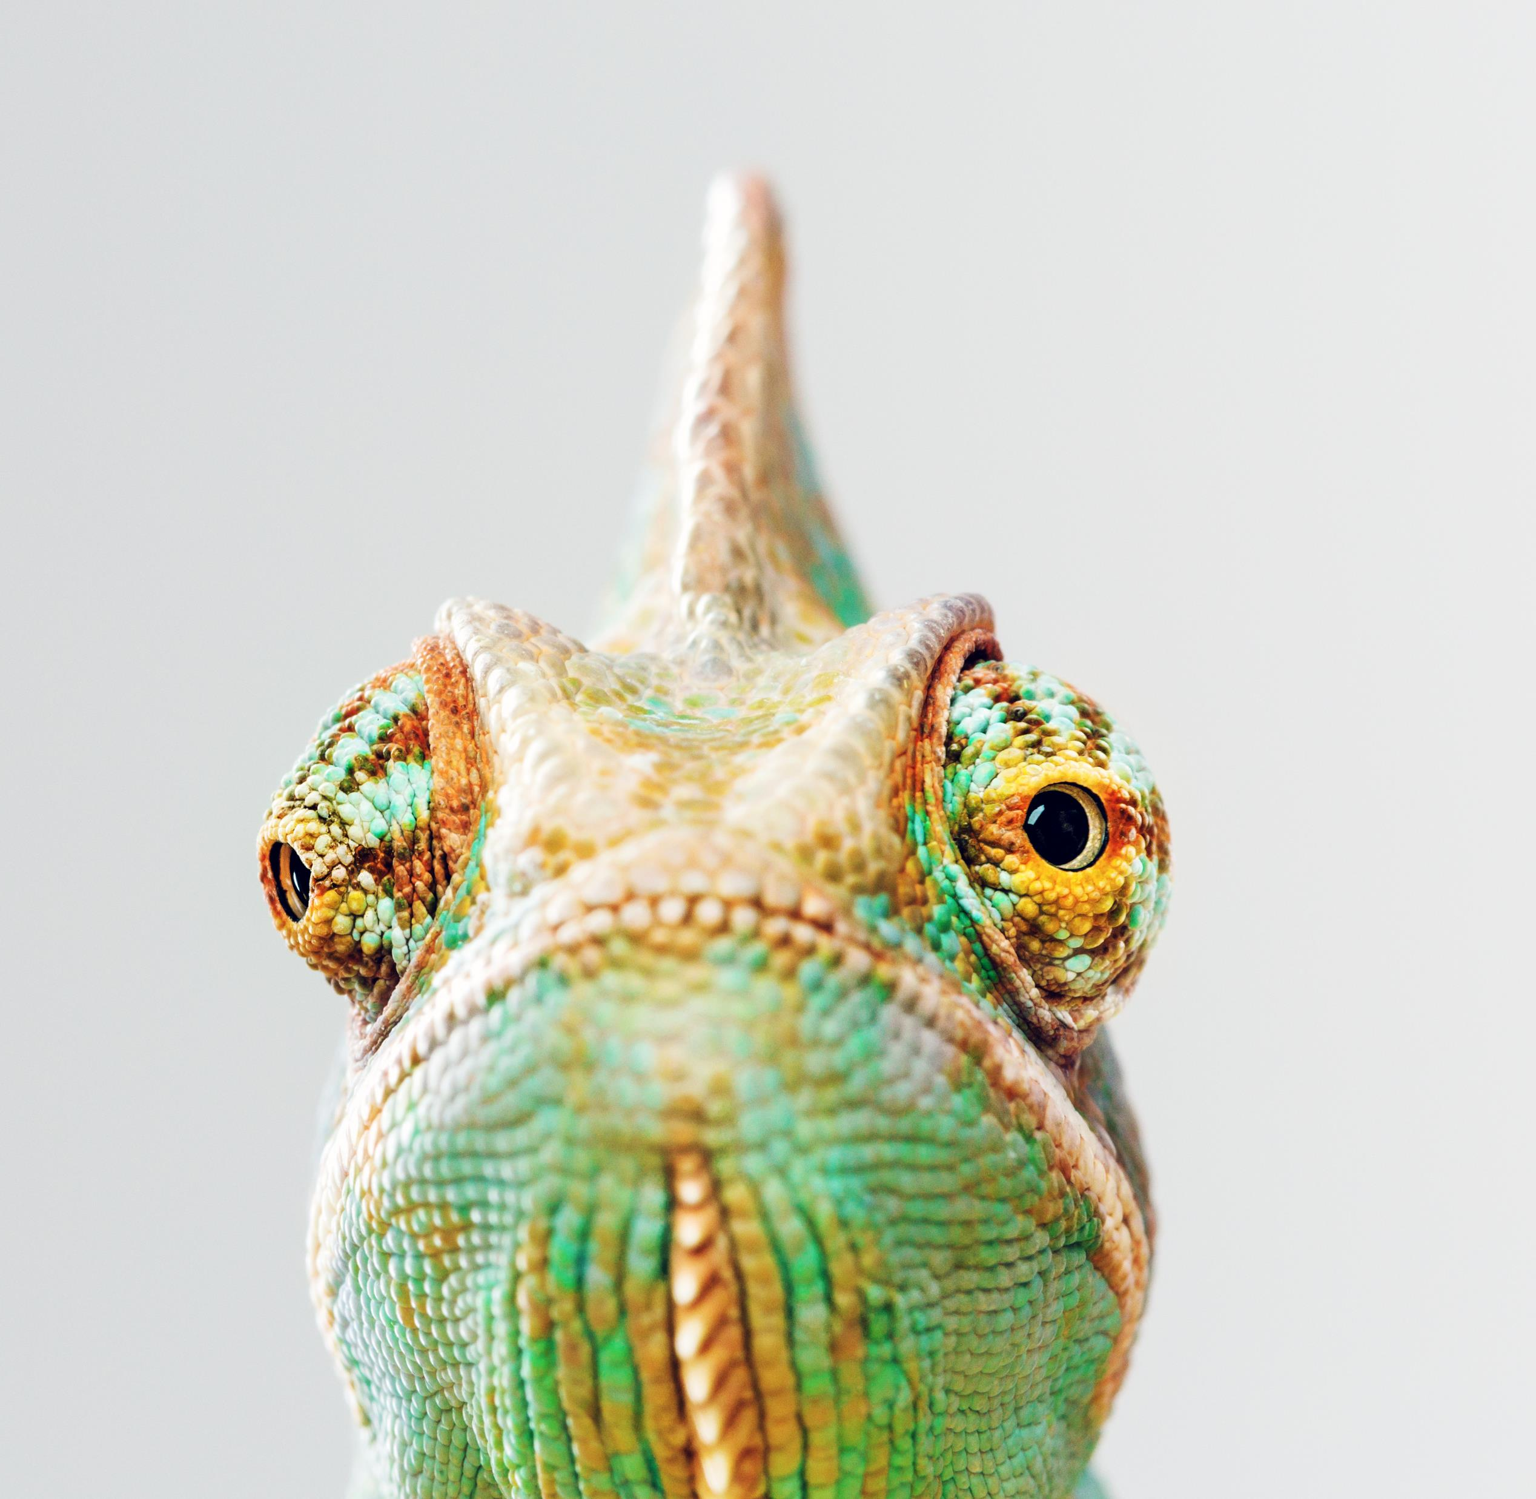
Chameleon
Tuesday 28th March 2023
Chameleon, where your contributions matter, and your potential is limitless.
Prepared by Chameleon Leadership (Juniors & Seniors)
Notes:
Hello Everyone and welcome to our presentation. Today we will be presenting our Company Chameleon goals for this Trimester

Slide 2




Chameleon Goals
Along with moving each of the Chameleon projects forward, closer to their overall goals, we have identified the following areas for improvement this trimester.
Define/document a policy creating and storing documents.
Document best practice for maintaining GitHub & re-organize.
Better define and document for the handover process.
Introduce cross-collaboration across all projects.
Introduce/define cyber security stress tests to all projects.
Implement a company-wide design plan.

Slide 3

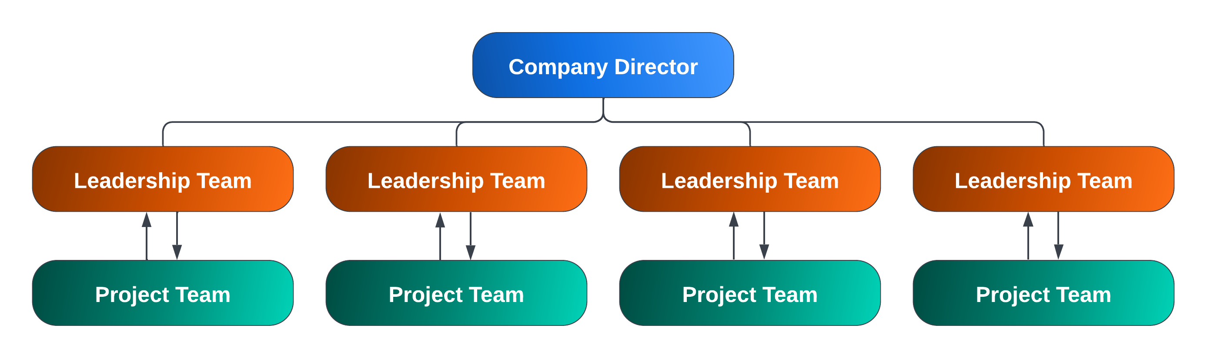
Company Structure & Culture
At Chameleon, we believe in fostering a dynamic and collaborative environment. Our team members are encouraged to make decisions and take ownership of their work. By empowering our team, we have created a culture of innovation that fuels the success of the company.
At its core, our culture is one of collaboration and teamwork valuing innovation and creativity. Team members are encouraged to think outside the box and come up with new ideas that can help the company achieve its mission.

Slide 4
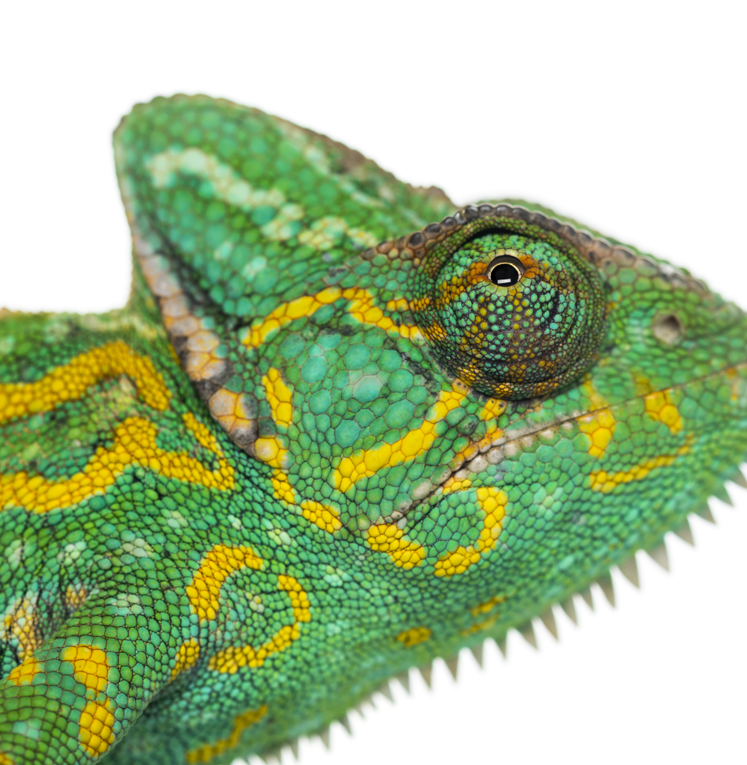
Current Core Projects
City of Melbourne Open Data
Chameleon Website
Electric Vehicle (EV) Adoption Tools

Slide 5

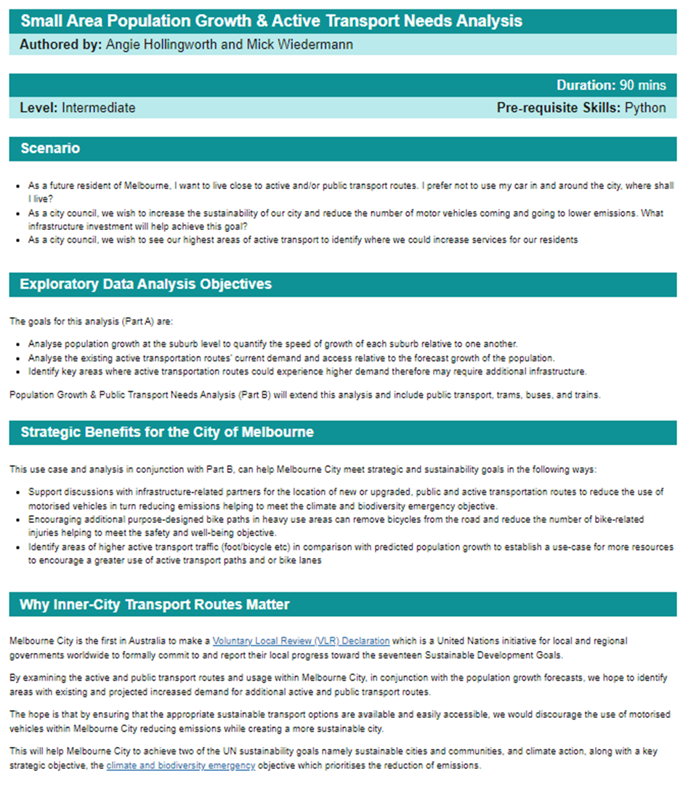
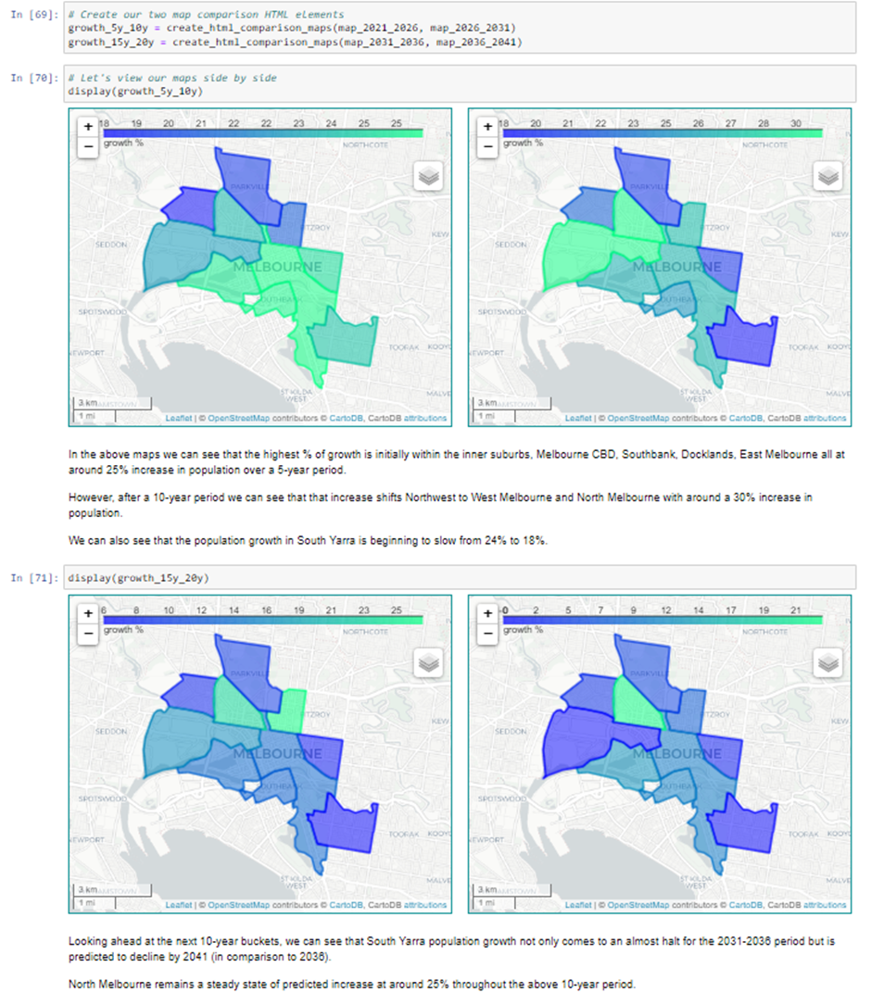
City Of Melbourne Goals
Data Science & Engineering
Define a new set of use cases & create a backlog
Update the APIs on all published notebooks
Update APIs on ready-to-be-published notebooks
Complete variety of new use cases
Web Development
Add mobile views & functionality
Create interactivity with JavaScript for the website.
Create multiple new use cases, allowing enough in the backlog for the next trimester.
Publish notebooks that are ready to be published.
Cleaner resources for handover procedures for MOP.
Fix the lingering design issues within the website.
Cyber Security
Identify vulnerabilities in source code, python code & database and document a roadmap to mitigate them

Slide 6
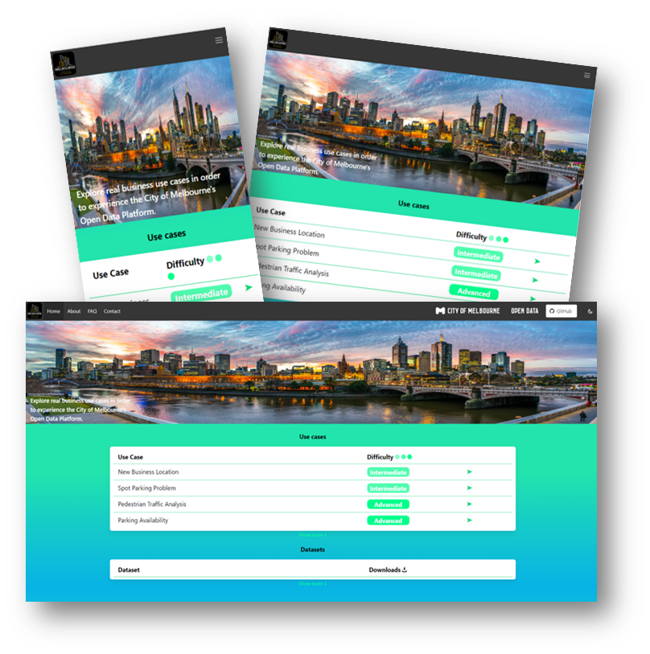
City Of Melbourne Updates
Data Science & Engineering
Client meeting - Introduced the new team and directive for T1
Completed two workshops to define new use cases adhering to the client's key business areas
Completed GitHub, python other relevant upskilling
Web Development
Team has set up development environments
Troubleshot the various issues
Finished upskilling
Started sprint 1, focussed on the inconsistent cosmetic changes & JavaScript interactivity on the home page
Cyber Security
Set out a Scope & Roadmap for how the team will proceed
Found an exposed port during initial investigations for the website
Team has set up development environments on various OSs
Completed upskilling
Working on sprint 1 deliverables & documentation

Slide 7
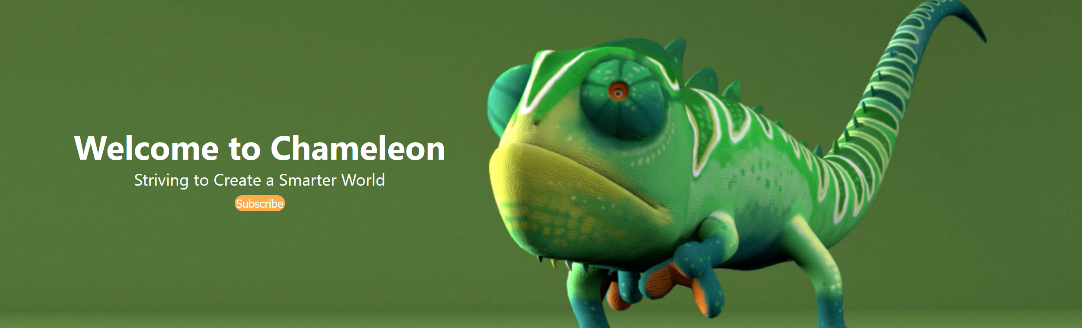
Chameleon Website The Chameleon Website’s aim is to provide a central location for information and progress updates on all the Chameleon company’s sub-projects.
Update:
Leadership and team members building out Trello team backlog
Juniors upskilling in Figma and creating low-fidelity wireframes
Weekly meetings being conducted, sprint 1 planned and members meeting outside of standard meeting hours
Tasks being assigned to team members regarding backend development and other database related queries
User personas created to expanded upon previous trimesters

Slide 8

EV Adoption Tools Goals
There are two sub-projects within EVAT.
The Evoleon App: Locates available charging sockets throughout Australia for users.
Continue building and adding functionality the user interface for the applications pages.
Update database with more EV charging locations.
Conduct a cybersecurity review of all the app’s authentication process, data storage, code in GitHub repository, and apps terms and conditions.
EVCFLO: Identifies ideal sites for new charging stations based on several key factors and assessed using big data.
Increase the EV Charger location database.
Integrate EVCS locations onto Google API Interactive map.
Implement website designs on the EVCFLO website using React.

Slide 9
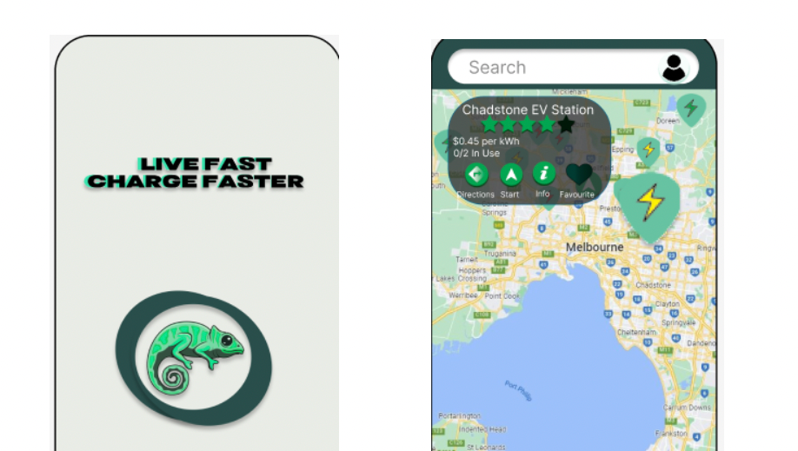

EVAT Update
Both EVCFLO and the Evoleon App have:
Held successful project planning meetings
Re-imagined the projects
Defined over 30 user stories (Combined)
Identified required tech stack and relevant upskilling
Began decomposing the user stories into backlog items and have started the first sprint.

Slide 10
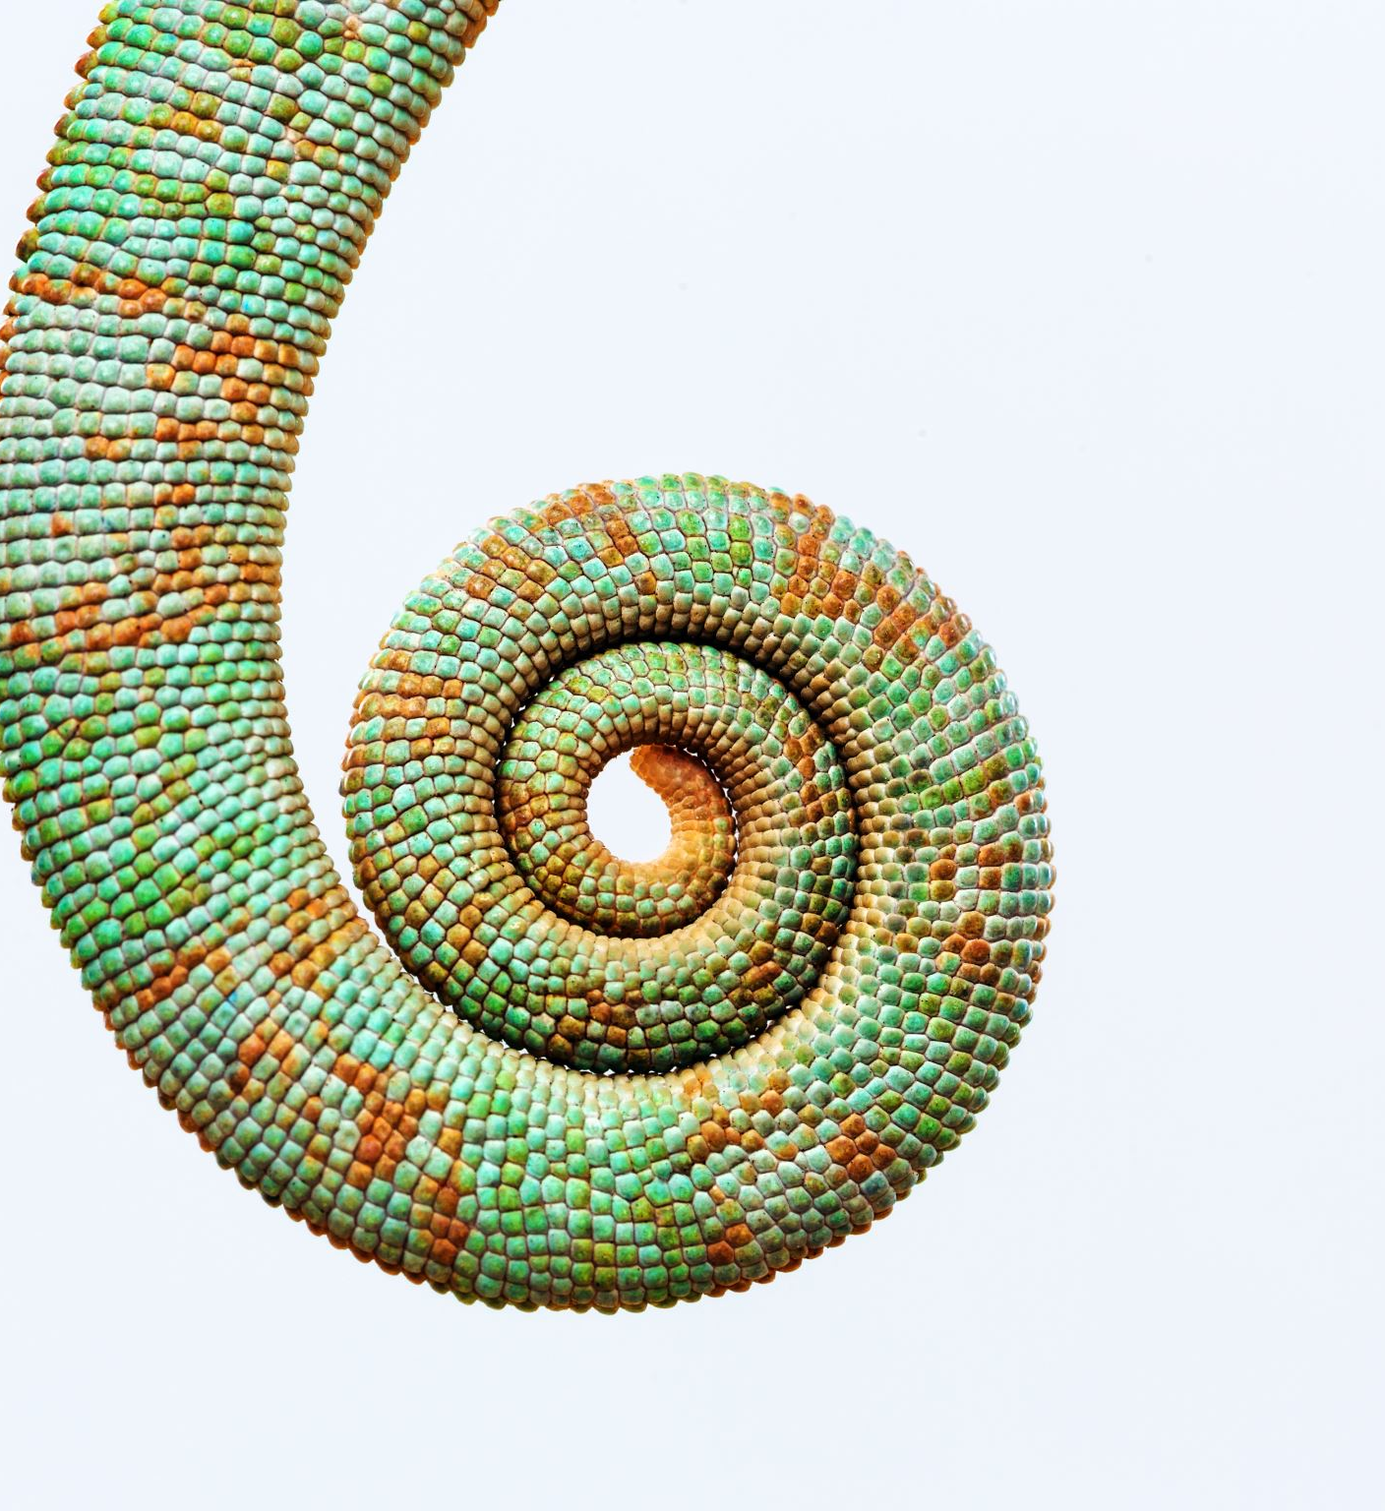
Any Questions?
Chameleon Wants You!

